Slide 1


ESSA
History of Accountability

Slide 2
Accountability Includes
Standards
Assessments
Public Reporting & Information
Awarding Performance
Intervention & Assistance

Slide 3
1978 – Basic Skills Assessment Program (BSAP) reading & math in Grades 3 and 8; writing in Grades 6 and 8 in 1983; and science in Grades 3, 6, and 8 in 1990
1983 - A Nation at Risk released; Prichard Committee in Kentucky promotes K-12 reform
1984 – Education Improvement Act (EIA)

Slide 4
1986 – BSAP Grade 10 Exit Examination administered; passage required to earn diploma in 1989
1989 – Nation’s governors adopt six National Education goals incorporated into federal “Goals 2000: Educate America Act”
1990 – Kentucky enacts Kentucky Education Reform Act

Slide 5
1990 - 1993 - SC developed Curriculum Frameworks at every grade level in core content and in arts and foreign language
1994 – Congress reauthorizes Elementary and Secondary Education Act (ESEA), Title I, requiring for first time states to have rigorous standards for all subjects and grade levels

Slide 6
1997 – Report of Performance and Accountability Standards for Schools (PASS) Commission
1997 – Guide issued by US Dept. of Education to state and local leaders: Turning Around Low-Performing Schools
1998 – SC enacts Education Accountability Act (EAA)

Slide 7
Original EAA
Standards in ELA, math, science & social studies updated cyclically
Assessments developed or procured to measure student performance against standards
School Report Cards – ratings for schools and districts
Technical Assistance to underperforming districts & schools
Palmetto Gold and Silver Awards program
Creation of EOC

Slide 8
Technical Assistance
Initially prescriptive intervention with EOC review, approval and evaluation
2008 – amended at request of State Superintendent to give oversight to SCDE
Since FY2009-10, governed by provisos in state budget & not by EAA
Beginning 2018, ESSA requirements apply

Slide 9
2001 – Congress enacts No Child Left Behind (NCLB) enacted – Adequate Yearly Progress (AYP)
2002- 2014 SC issued state report cards
2005 SC made largest gains nationally in 8th grade math and second largest gain in 4th grade math on NAEP. Ranked 28th nationally.
2006 - All states required to have assessments and measure AYP

Slide 10
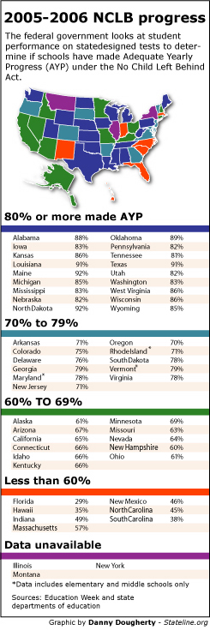
% Schools Meeting AYP
Florida – 29%
South Carolina – 38%
North Carolina – 45%
New Mexico – 46%
Indiana – 49%
Massachusetts - 57%
North Dakota, Maine – 92%
Texas – 91%
Alabama – 88%
Mississippi – 83%

Slide 11
2009 – Common Core standards project – SC joined by action of Governor and State Superintendent
2009 - 2014 High School Assessment Program Passage required to earn diploma
2010 – State Board of Education and EOC adopt Common Core State Standards for ELA and math. Full implementation was to occur in 2014-15 school year.

Slide 12
2014 – Act 155 eliminates exit exam (HSAP) requirement and replaces with college and career assessments; Act 200 prohibits Common Core implementation and removes SC from Smarter Balanced Consortium; three years of no report card ratings (2015-2017)
2015 – Congress enacts Every Student Succeeds Act (ESSA)
2017 – Act 94 merges state and federal accountability systems and includes cyclical review of accountability

Slide 13
Overview
2002- 2014 Accountability dictated by federal and state law; SC had separate state accountability system
2015 - Present Accountability required but many decisions left to states’ discretion, and SC merged state and federal systems into one system
2018 – Online report cards resumed

Slide 14
Explanation of Current Report Card Ratings
100-point scale
Overall ratings for schools only
Ratings for each metric or indicator
Ratings: Excellent, Good, Average, Below Average, and Unsatisfactory

Slide 15
Elementary & Middle Schools
Academic Achievement – ELA & Math assessment results*
Student Progress in ELA & Math
Preparing for Success - Science & Social Studies assessment results
School Quality - Student Engagement Survey
English Learners’ Proficiency*
* Federally required

Slide 16
High Schools
Academic Achievement – Assessment results in ELA (English 1) and math (Algebra 1)*
Graduation Rate*
College & Career Ready
Preparing for Success – Biology & US History and the Constitution
School Quality - Student Engagement Survey
English Learners’ Proficiency*
* Federally required

Slide 17
Policy Considerations
What state and federal resources are targeted to assist underperforming schools?
How will state ensure funds are spent on evidence-based practices as required by ESSA, and how will state document impact?
Does state have a sufficient continuum of tiers of intervention for underperforming schools?
Does state have explicit benchmarks to document progress between tiers?

Slide 18
Policy Considerations
What strategies will state use for intervention strategies? Options include:
Use portion of federal or state appropriation for competitive grants to schools and districts with strongest improvement plans
Allow third parties to manage schools
Close or reconstitute the school
Student transferability
Family & community engagement
Sustainability plan
See: https://checkstateplans.org/

